Slide 1


CORPORATE PROFILE
V Zone International L.L.C.
Post Box 95607 Dubai - U.A.E, Tel: +971 4 238 9906, Fax: +971 4 238 9907
E-mail: info@vzoneinternational.com , Website: www.vzoneinternational.com
US - UK - UAE - OMAN - QATAR

Slide 2

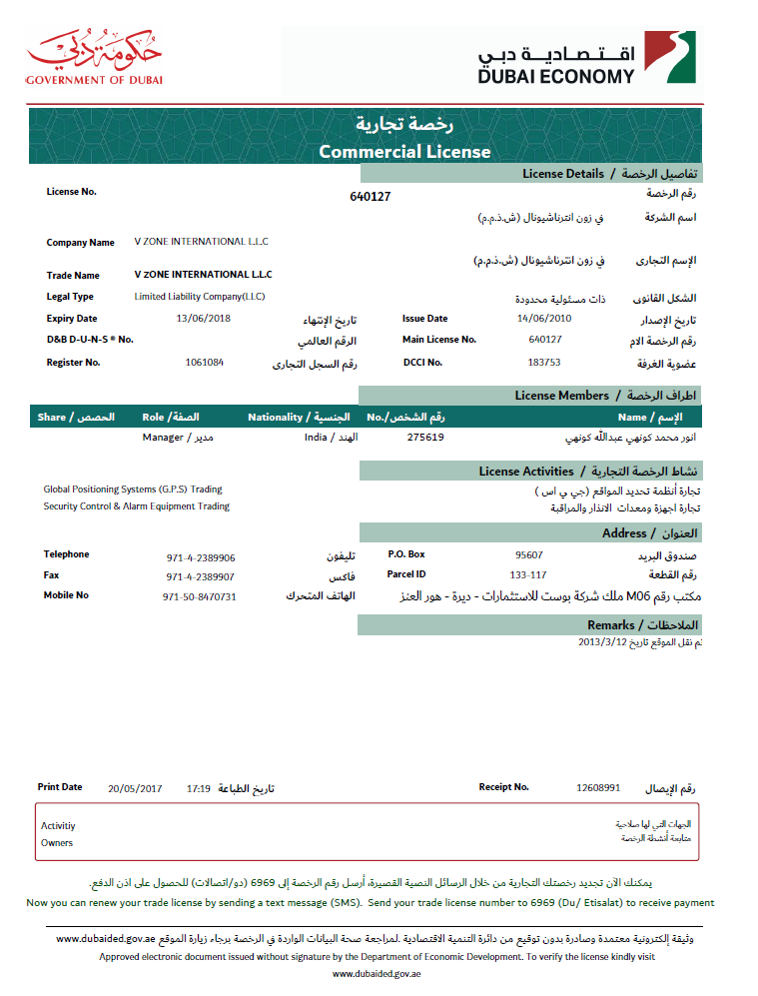
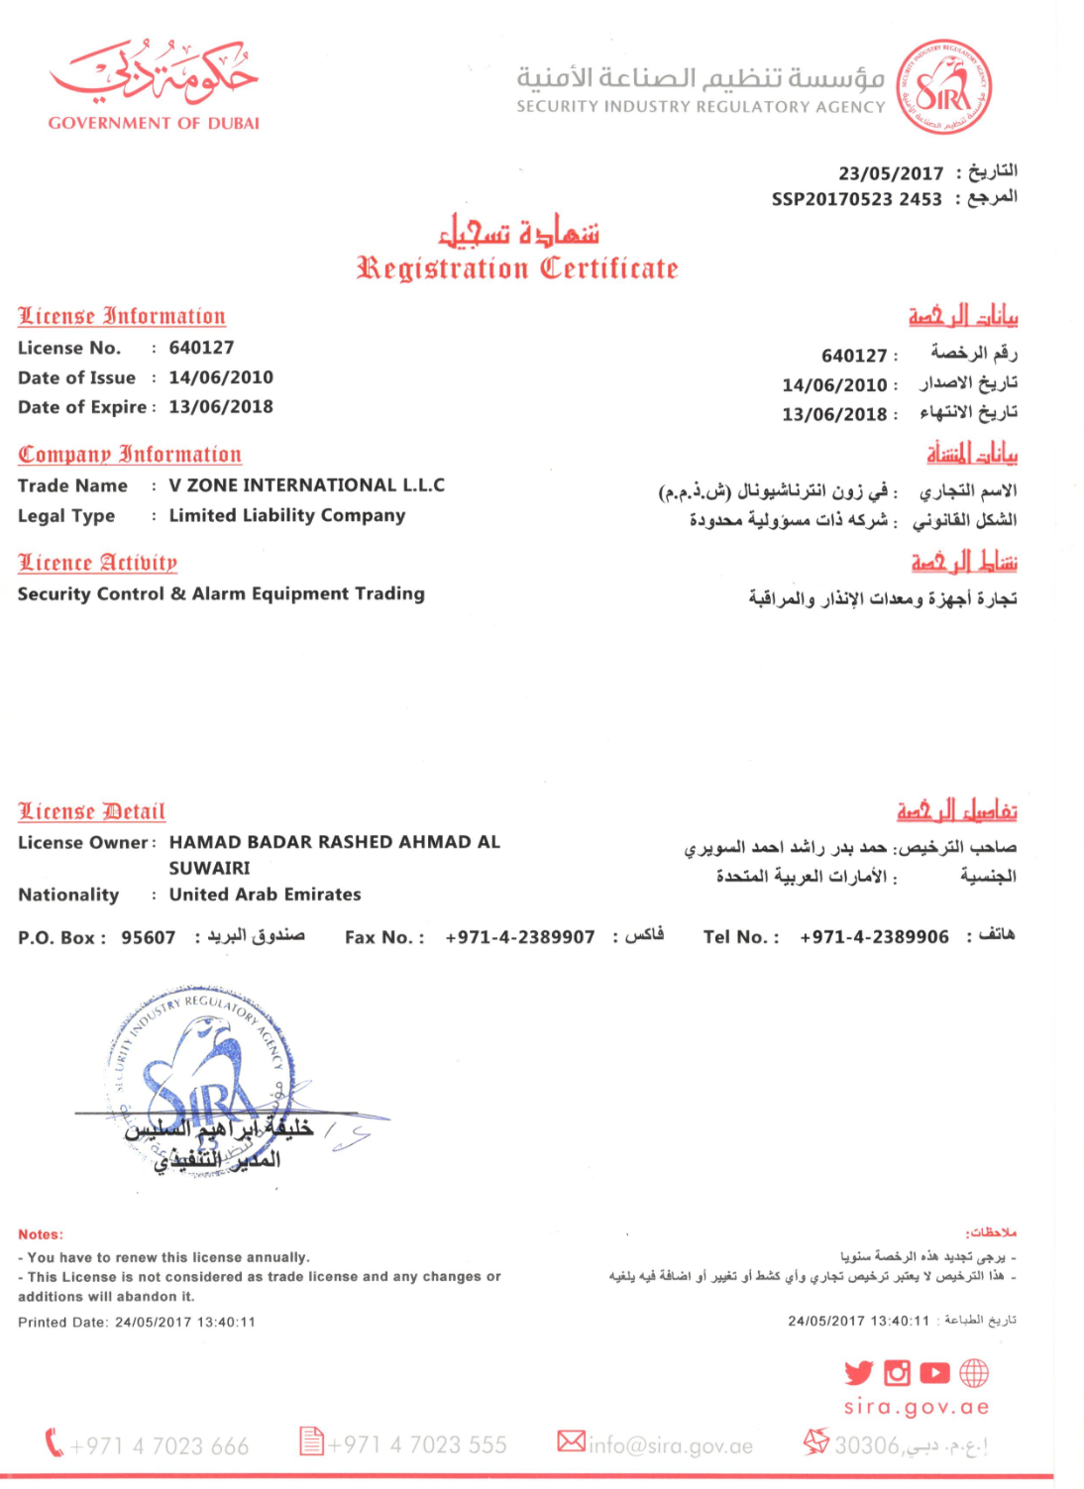
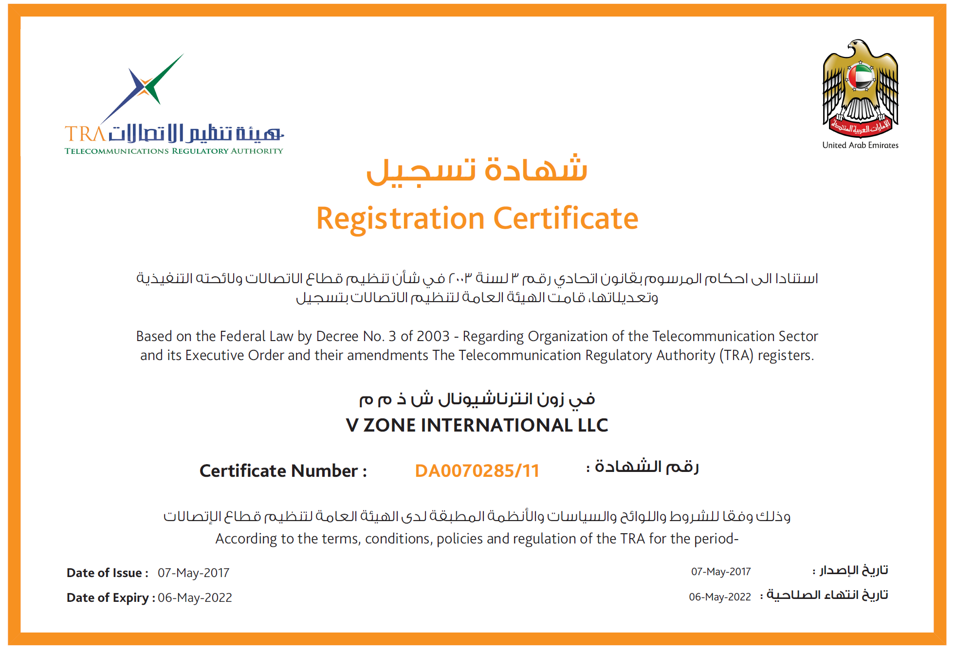
COMPANY BACKGROUND
Established in 2010 in United Arab Emirates, Vzone International LLC has been creating innovations in GPS technology for 9+ years. With 2 of the top 5 fleets in UAE as customers, VZone International LLC continues to innovate with customer-focused solutions.

Slide 3
Considered to be one of the top 5 enterprise solution providers in the GPS-based services industry, Vzone International has created a reputation for:
Accurate GPS recording system that Precisely captures trip distance and events
Creating customer/home/office landmarks
Comprehensive data Management – hosted or on client network
Driver specific as well as vehicle performance reporting
User friendly Software that is simple to use with value for multiple users within an organization (dispatch, admin, safety, fleet, sales, etc. )
Engine diagnostics and sensor data

Slide 4

VISION
Our vision is to become the first GPS tracking manufacturer to reach all continents with world class and unique services to the customers through enhancing and optimizing the customer business activities.

Slide 5
MISSION
Our mission is to provide the easiest, most cost effective and accurate positioning solutions for locating vehicles and to provide both current and historic information in relation to driver and vehicle behavior. Perfect communication and customer service will be the backbone for earning new business while maintaining the highest levels of customer retention.

Slide 6
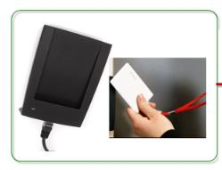
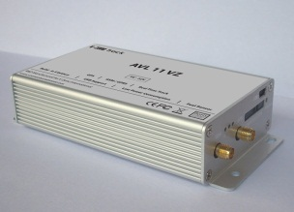
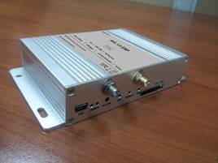
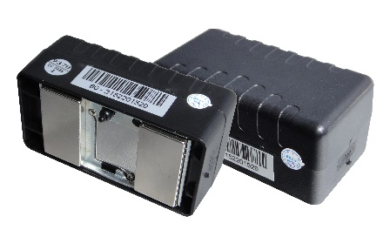
PRODUCTS RANGE
GPS Vehicle Tracking
The GPS Vehicle Tracking System allows fleet managers to track vehicles in real time. The current position of the vehicle, status, the speed at which its travelling, fuel status, driver, trip route etc. The associated Web application displays the vehicle movement in Google Map.
GPS Vehicle Tracking System - V Zone Track : Displays current status, location, speed, distance and routes travelled by any vehicle

Slide 7
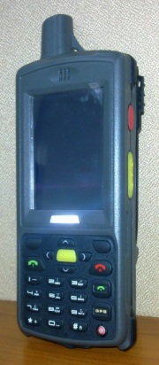
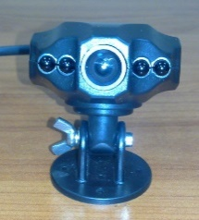
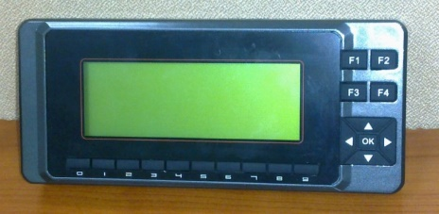
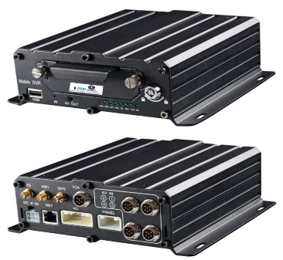
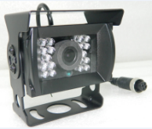
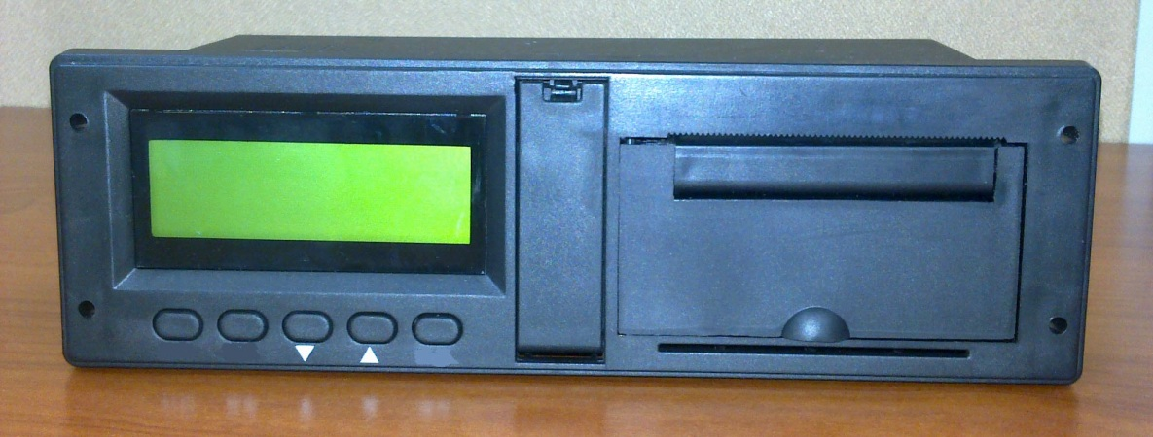
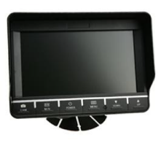

PRODUCTS RANGE
GPS Accessories
The Accessories establish two way communication between the client and drivers. These devices can be easily connected to the GPS system.
RFID Reader : Reads the RFID card and data to the server via GPRS.
In Vehicle Camera : It is connected to the SOS button of the GPS device. It captures images and send them to the client in case of an emergency.
Handset Phone & LCD : Voice communication and SMS support to client made comfortable.

Slide 8
FACILITIES
Locate / Multi Track.
Live tracking / Trip View / Total distance driven
Idle status.
History tracking and locate.
View vehicle location and status in real time (i.e. if vehicle is stopped, moving or idling and driver behavior reports).
Estimated Trip Distance by time.
Schedule disables the vehicles from time to time.
Enable /Disable the vehicle by remotely thru the website / SMS .
Gradual motor arrest
Alert by email and SMS
Manage all the vehicle thru application
Tow detection.
Driver Behavior Analysis:
1- Harsh Breaking alerts
2- Course change
3- Over Speed.

Slide 9
GPS Tracking
FEATURES & BENEFITS
Item | Deliverables | Advantages
Tracking | Live vehicle Locations /Speed / Status Summary reports: Daily/Monthly Driver info | Real time info of the fleet More control – Less Misuse Planned Vs Total km travel : Misuse is identified. Higher management have idea about the Macro level performance.
Trips | Trip based Reports | Deliveries under track Early work finish is under scanner Multiple trips are planned
Alerts | Alerts : Excess idle / Stop, Off-time movements | Real time notification of the violations Proactive actions to stop missuses.
Status Charts | Status : Travel, idle , Stop Timeline Based Status | Easy bird eye view for management. Productivity can be accessed on macro level. Vehicle allotment based on utilisation

Slide 10
Temperature Sensors
FEATURES & BENEFITS
Item | Deliverables | Advantages
Quality Control | Live TEMP. Status Trip based TEMP. reports | Real time info of the TEMP. More Quality control – Driver More Focused Better Auditing Reports based on Clients deliveries
Alerts | High TEMP. Alerts Low TEMP. Alerts TEMP. Restore Alerts | Real time & Proactive Quality control Fleet Coordinators More FOCUSED ~95 % violation alerts reduced in SHJ
Reports | TEMP. Event Log Reports | Better auditing of TEMP violations Higher visibility for management and QC Dept.
TEMP. Event Log Reports | Time Vs. TEMP. Graph Temp at Each product delivery | Comprehensive Quality control Simple and Productive Auditing

Slide 11
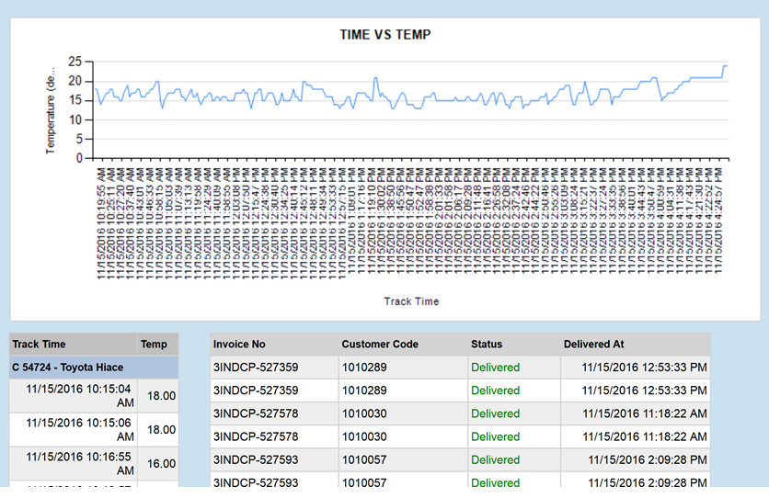
FEATURES & BENEFITS

Slide 12
FEATURES & BENEFITS

Slide 13
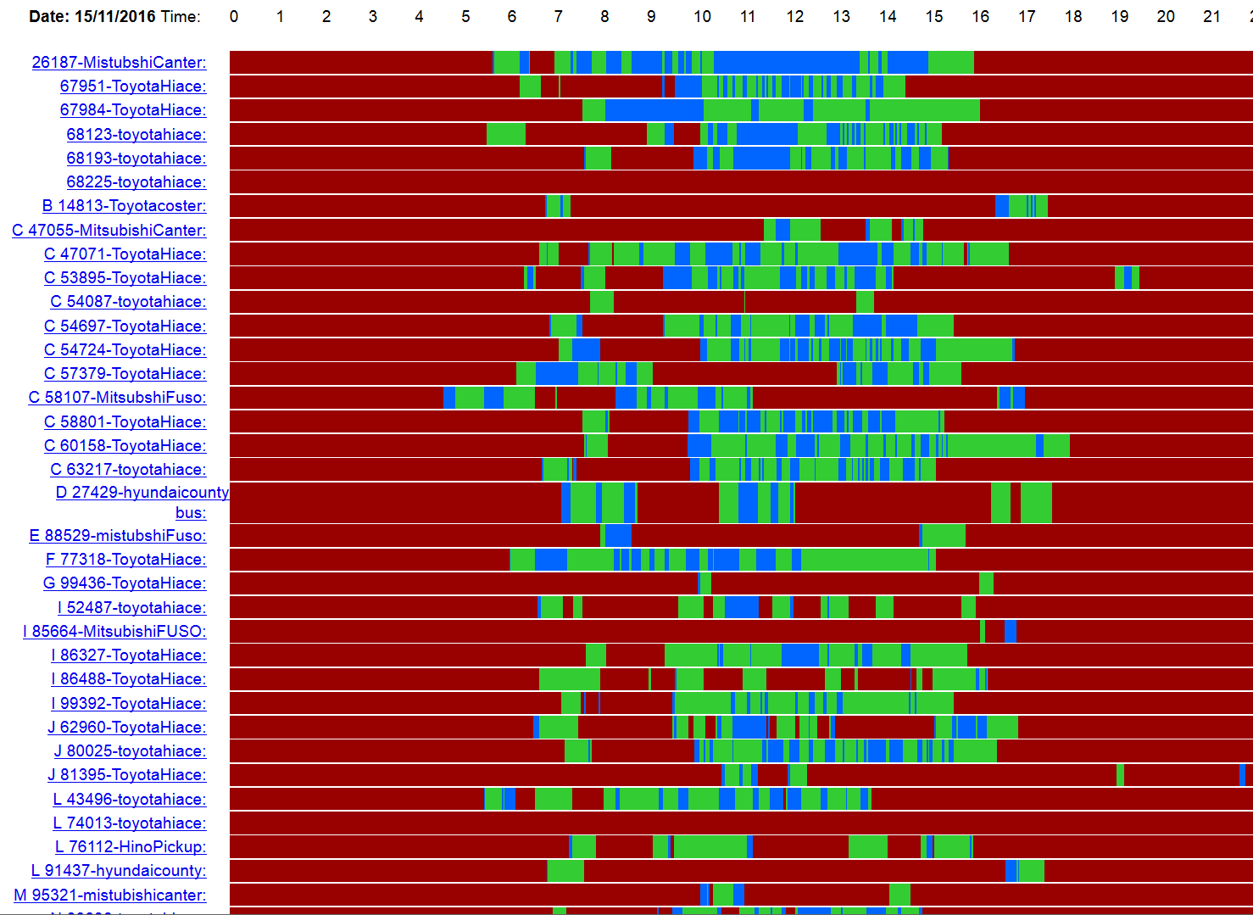
FEATURES: Status Chart

Slide 14
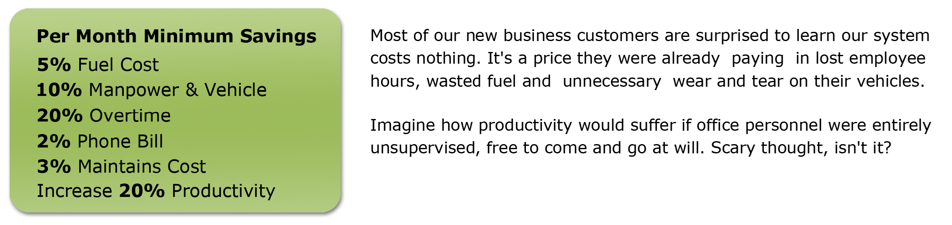
FEATURES & BENEFITS

Slide 15
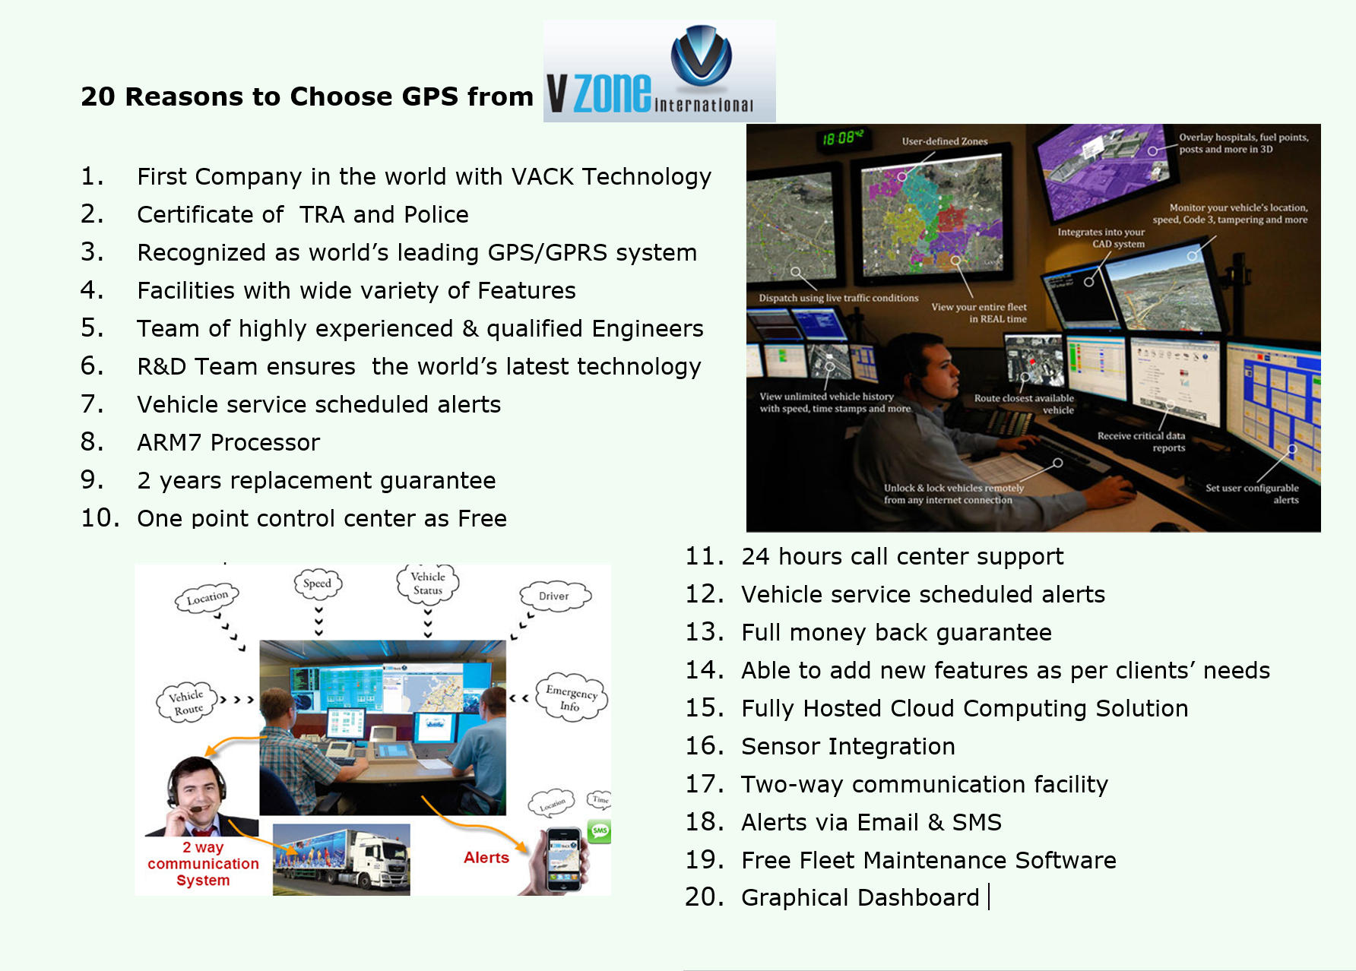
BENEFITS

Slide 16
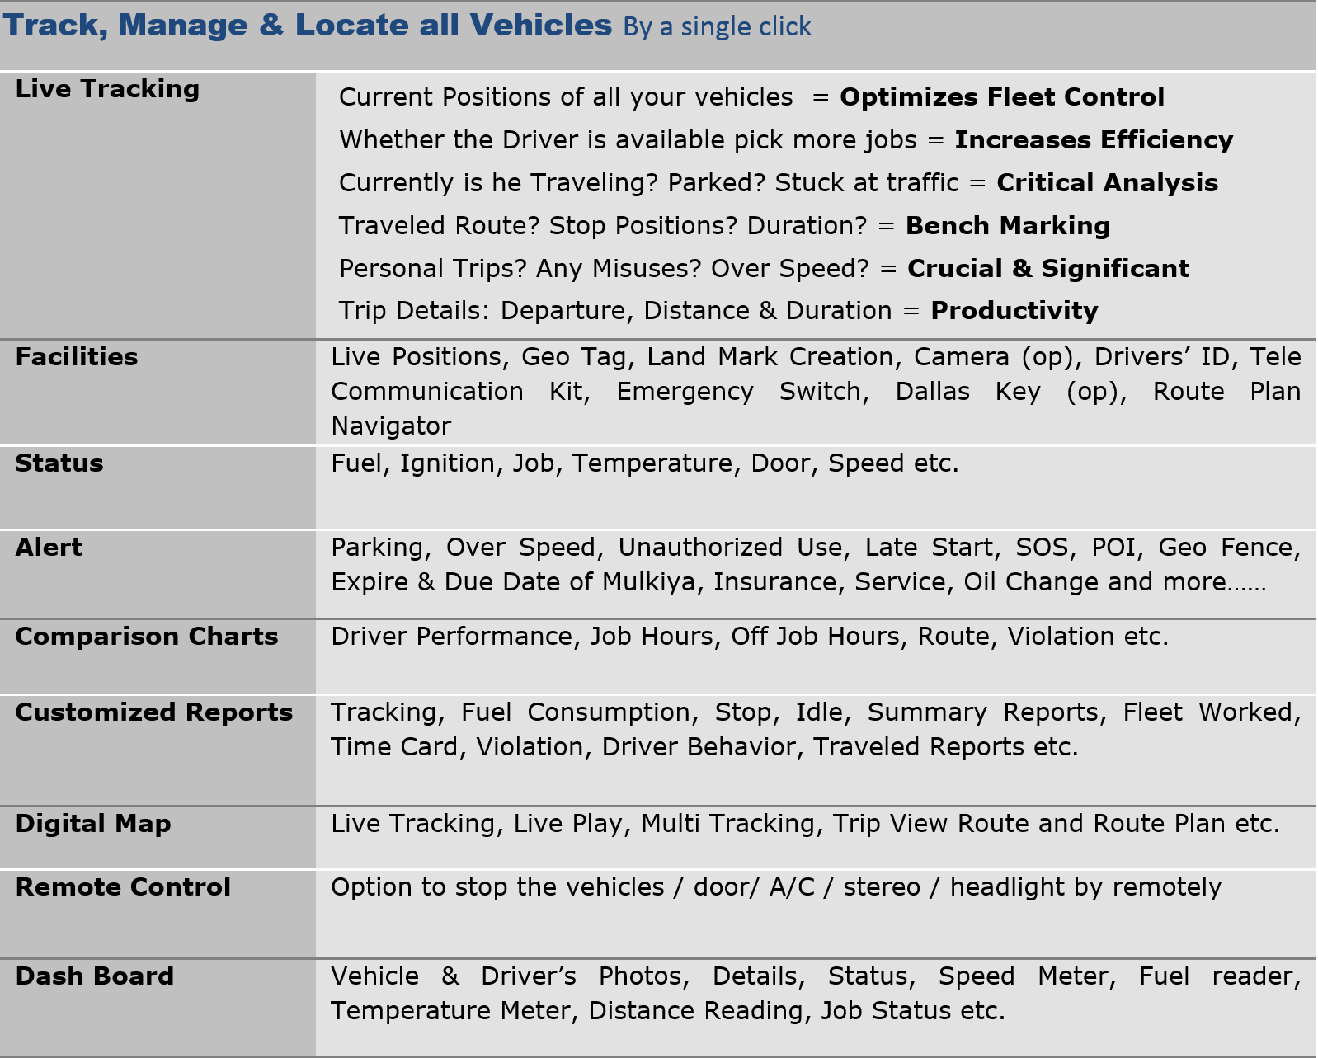
BENEFITS

Slide 17
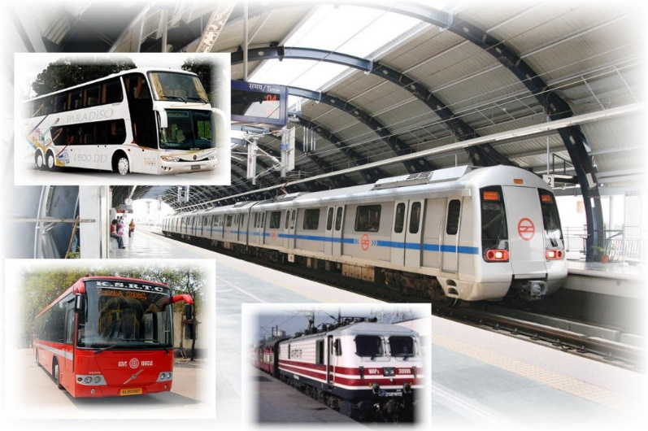
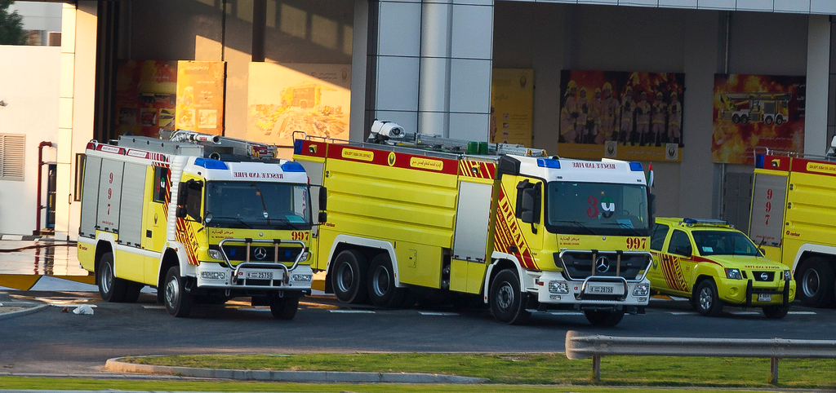

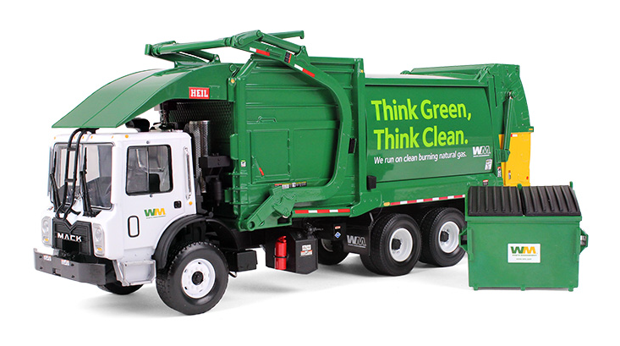

Potential Customers
Govt
Public Transport
Public Distribution System
Health
Police Vehicles
Fire Brigade
Solid Waste Management
Ambulance Service
School Bus

Slide 18
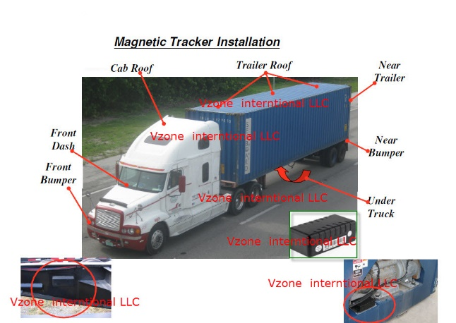
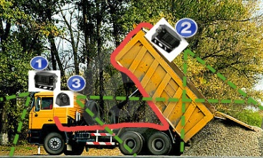



Potential Customers
Business
Logistics
Call Centers / BPO
Cabs
Rent a Car
Sales Force Monitoring
Misc
Car Security
School Bus

Slide 19
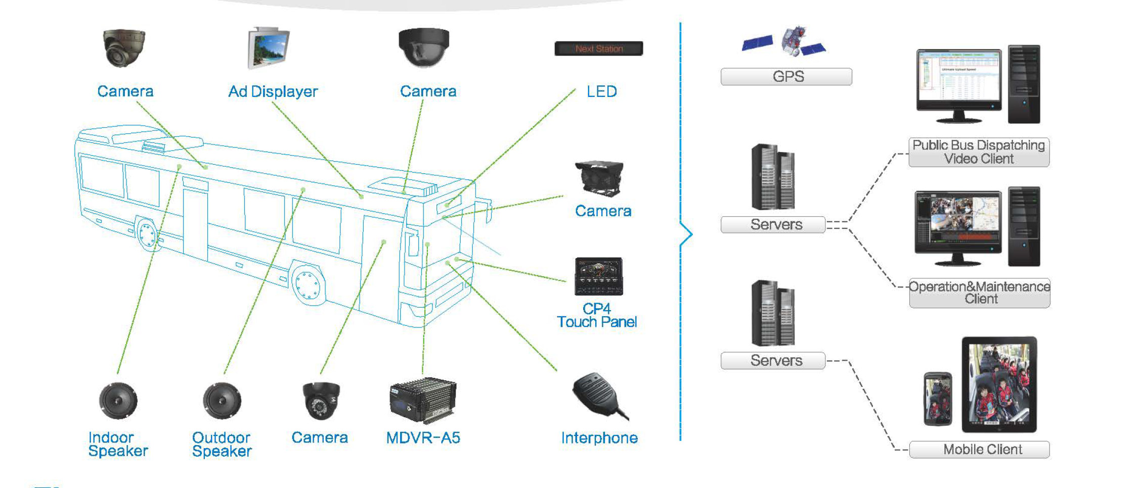
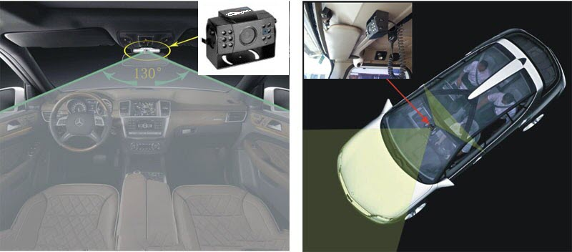
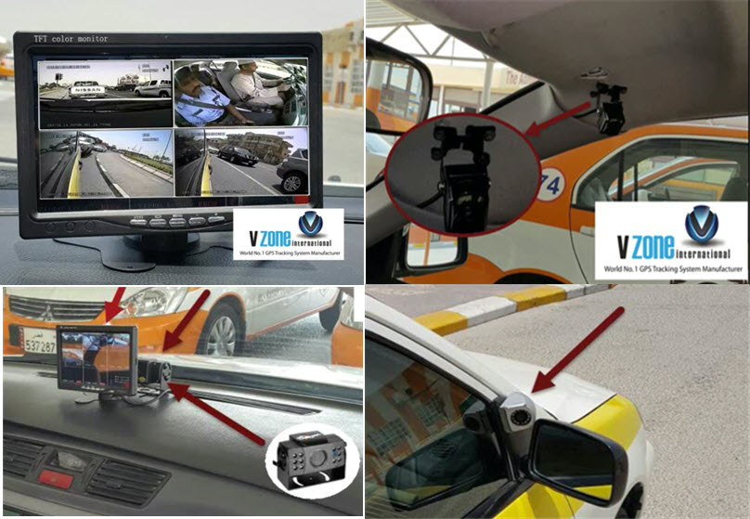
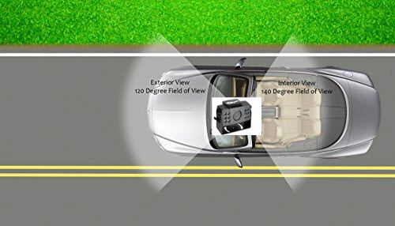
Custom Applications
Govt. Transport / School Bus Camera Monitoring System
Driving School Road Test Monitoring System

Slide 20
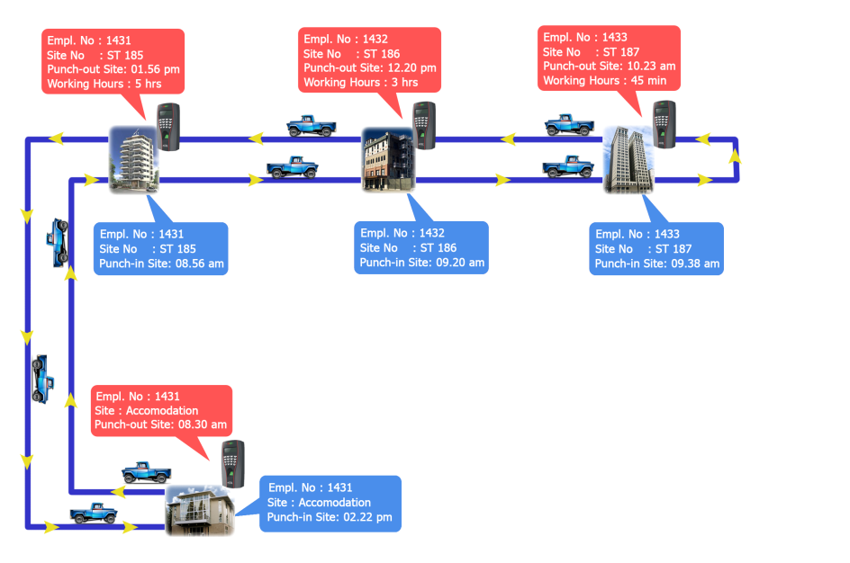
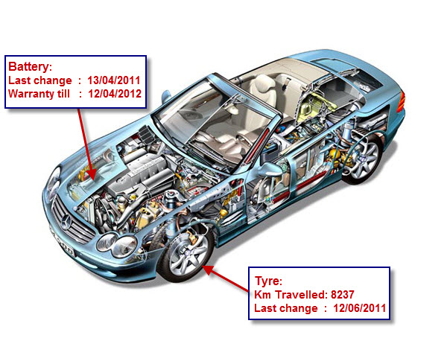
Custom Applications
Attendance system with GPS
Maintenance & expense monitoring Applications

Slide 21
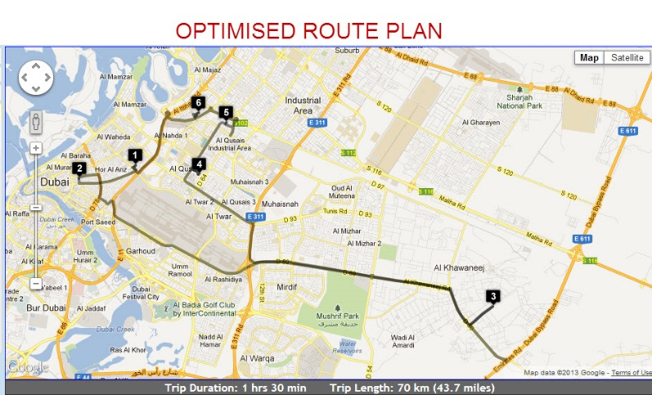
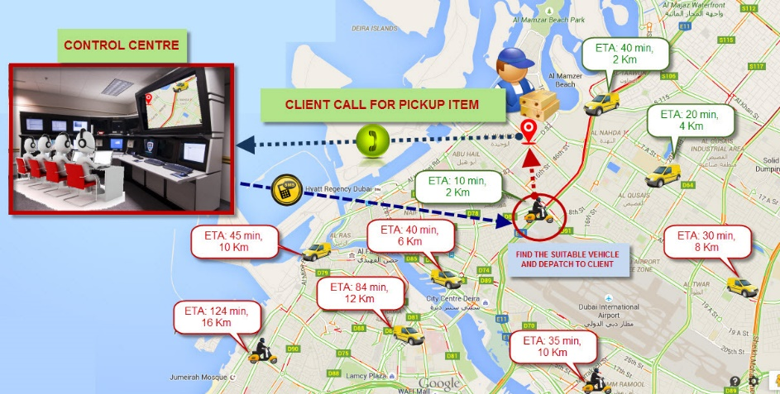
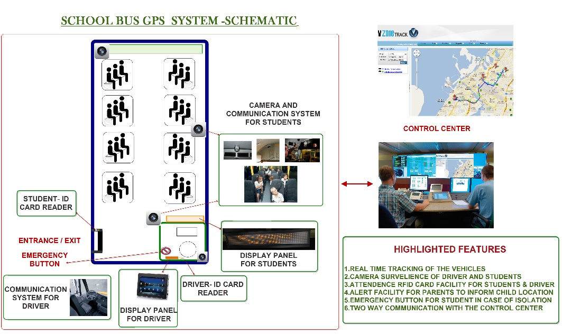
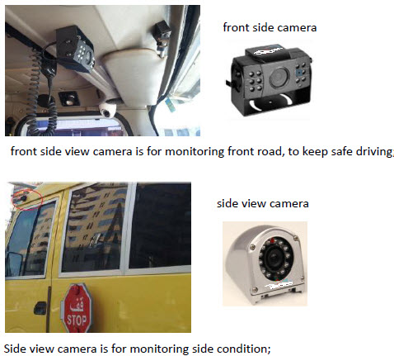
Custom Applications
Automated Routing software
School bus Tracking –Student Applications

Slide 22

500+ Clients worldwide And Still Growing…

Slide 23
www.vzoneinternational.com
CORPORATE OFFICE
PO Box 95607 Dubai, UAE
(Tel : +9714 238 9906, Fax: +971-42389907)
For more information please contact to us Business@vzoneinternational.com

